Slide 1



Mini-Shell Project
Group Members :
Samama Farooq
Allah Rakha
Sohaib Ahsan

Slide 2

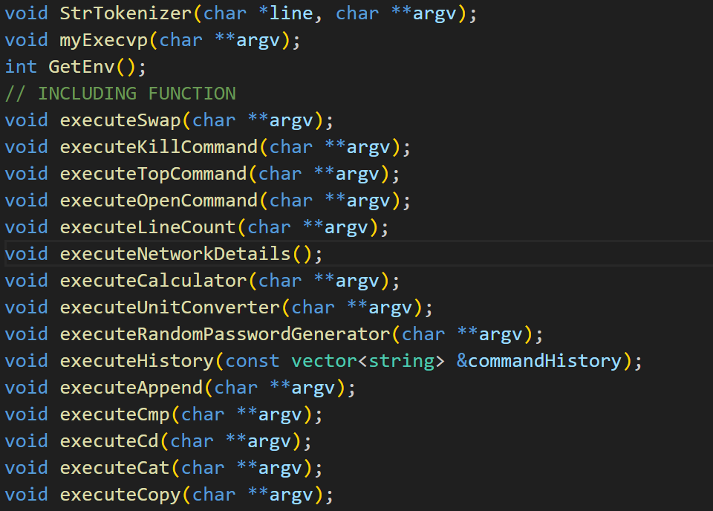


Customized Commands
Swap
Kill
Line Count
Append
Cmp
History
Password Gen
Top
Open
Cd
Network Det.
Calculator
Unit Conv.
Remove
Copy

Slide 3

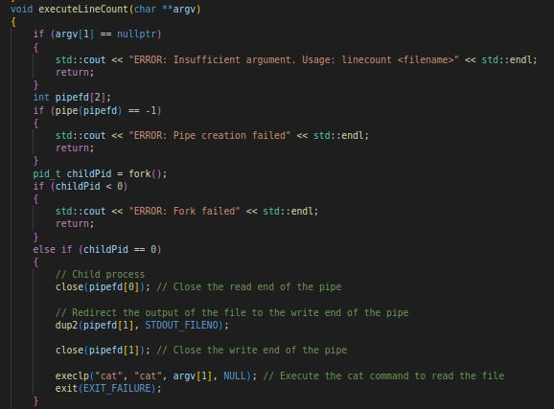


01
LINE COUNT
This command is used to count the number of lines in a file using pipelining. The parent process creates child process for each line in the given file.

Slide 4

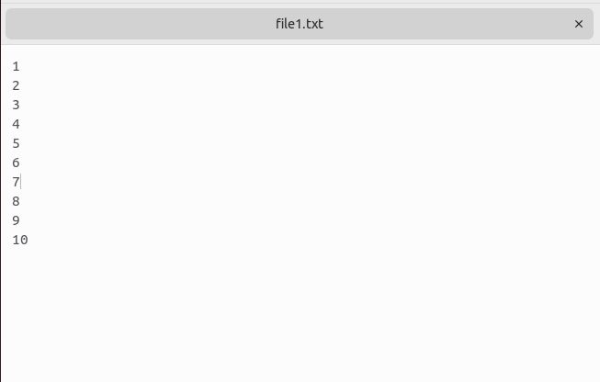


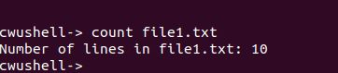
Line Count
01

Slide 5
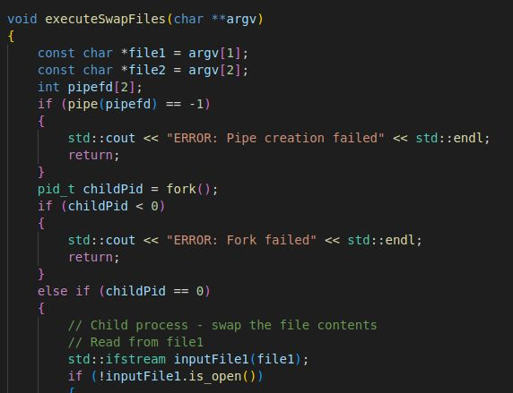
02
SWAP
This command allows us to swap the contents of two files with each other.

Slide 6
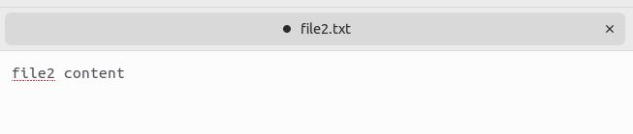
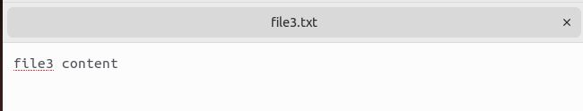
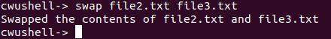
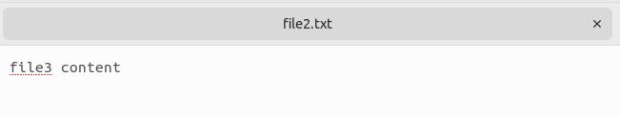
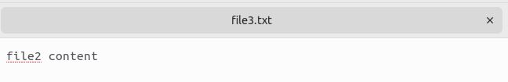
SWAP
02
BEFORE
AFTER

Slide 7
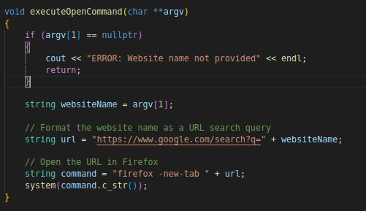
03
OPEN
This command allows us to navigate to the given website name.

Slide 8
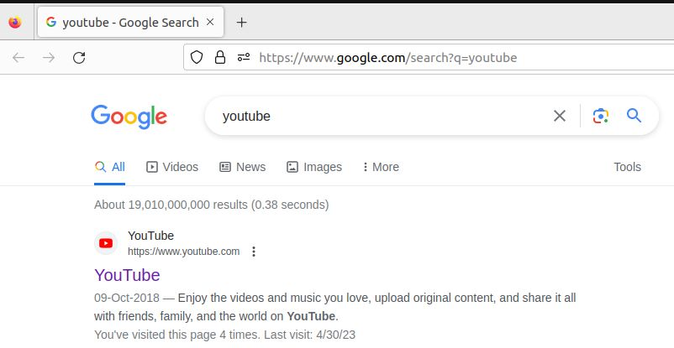
OPEN
03

Slide 9
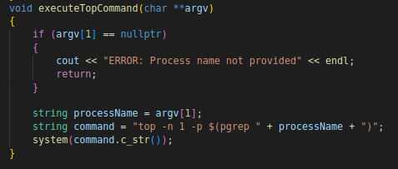
04
TOP
This command allows us to display the resources used by the specified application.

Slide 10
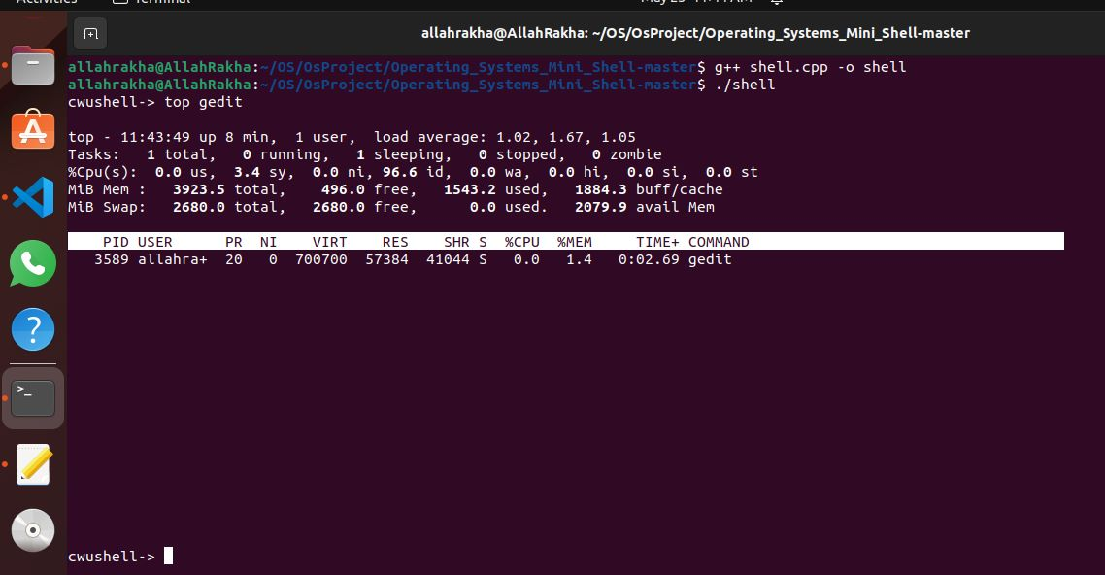
TOP
04

Slide 11
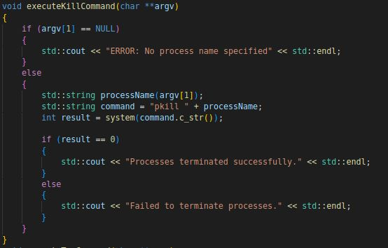
05
KILL
This command allows us terminate a specified process by name not by pid.

Slide 12


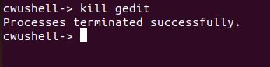
KILL
06
BEFORE
AFTER

Slide 13
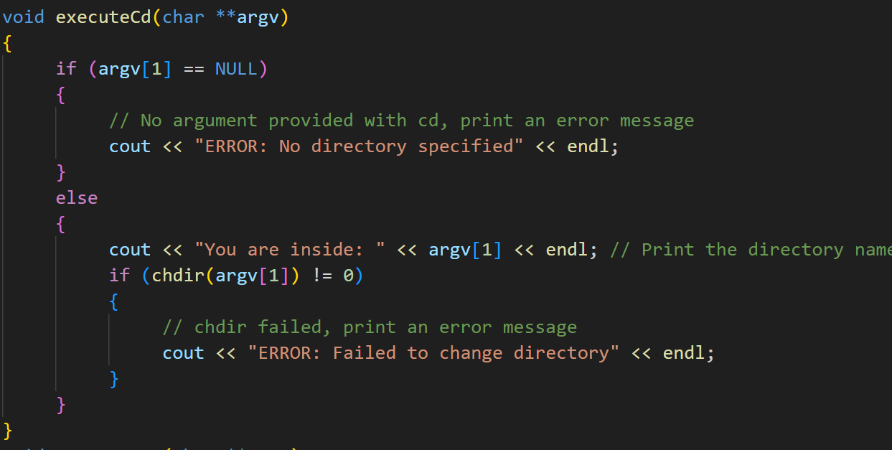
06
CD
This command allows us to display the current working directory.

Slide 14
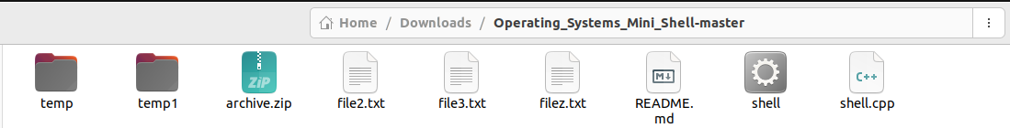
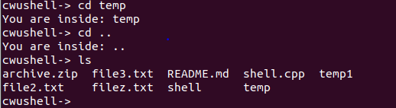
CD
06

Slide 15
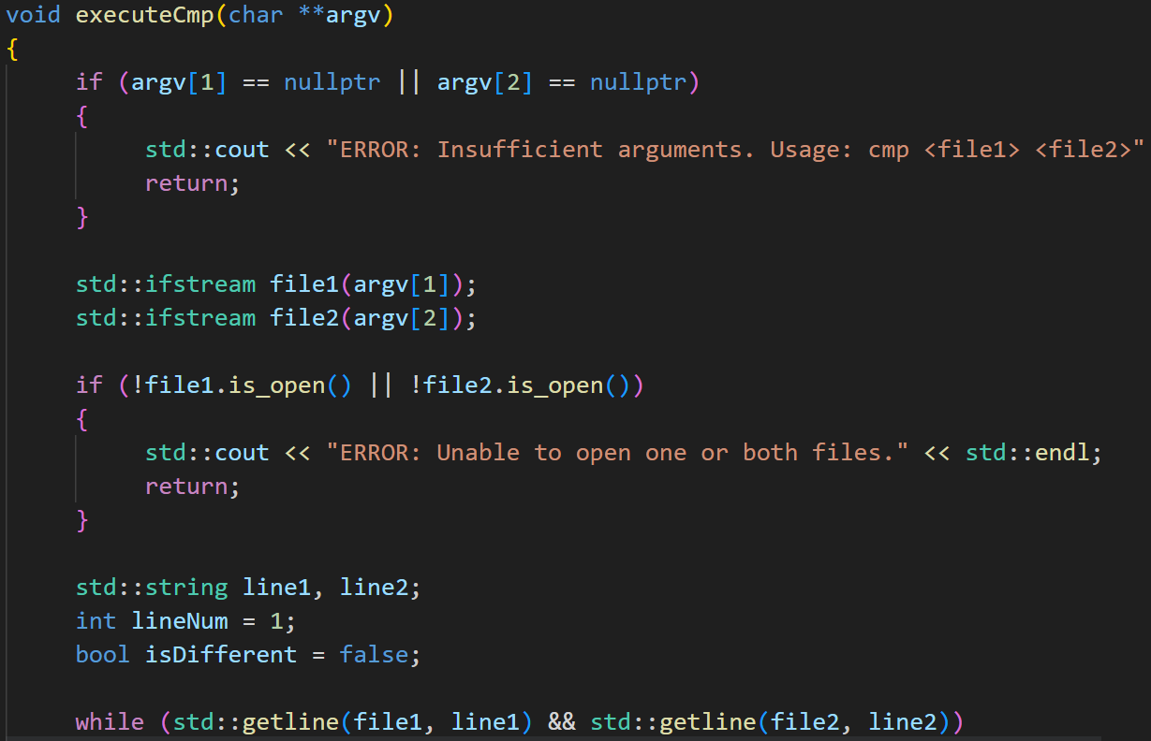
07
CMP
This command allows us to compare the contents of two files

Slide 16
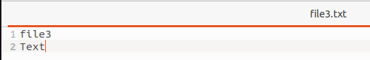
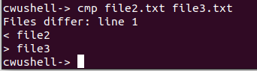
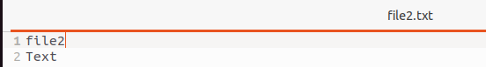
CMP
07

Slide 17
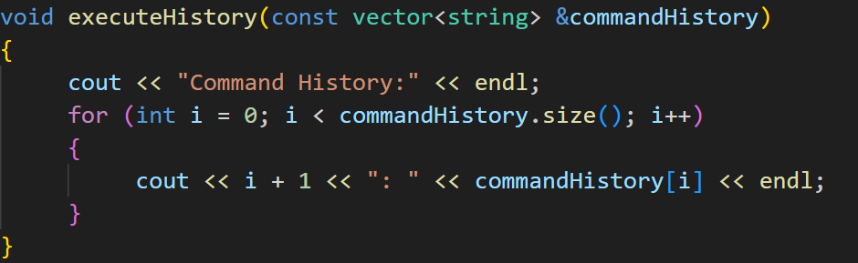
08
HISTORY
This command allows us to display our command history.

Slide 18
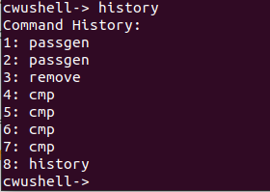
HISTORY
08

Slide 19
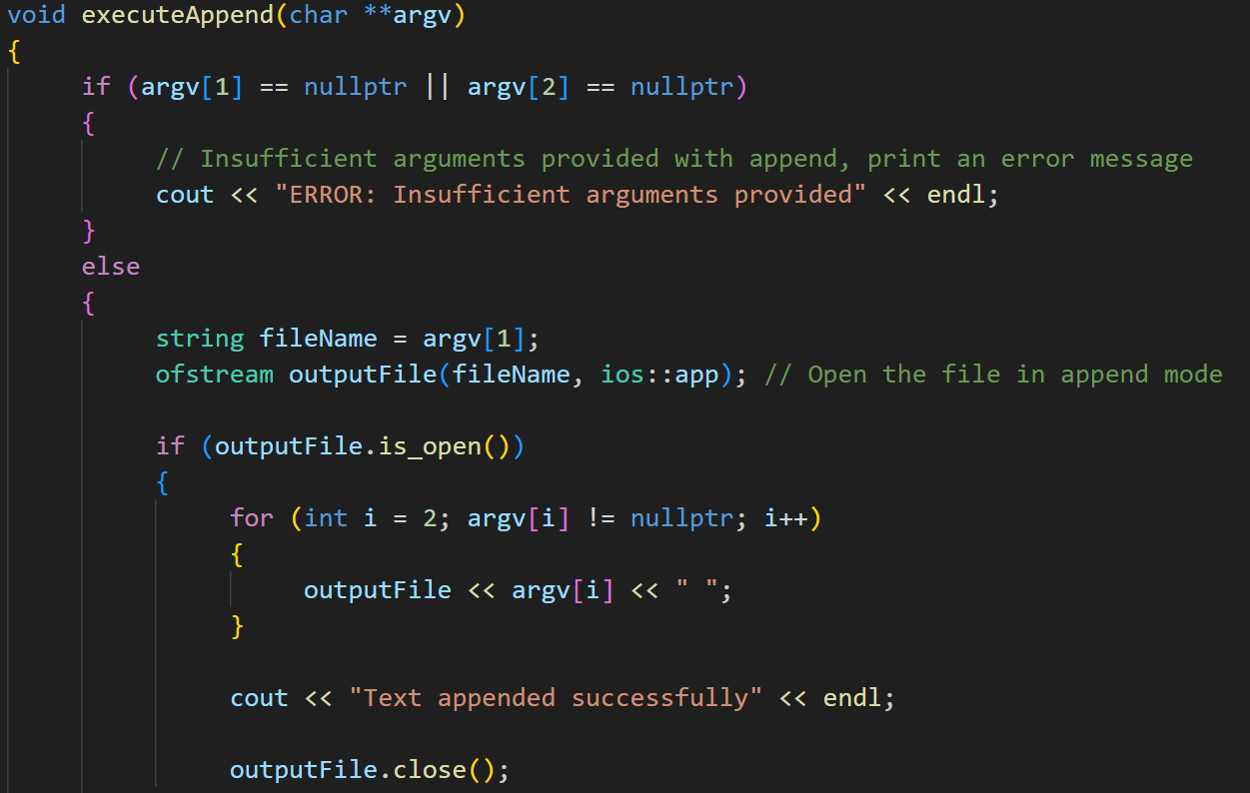
09
APPEND
This command allows us to append contents into any given file.

Slide 20
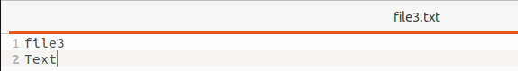
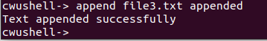
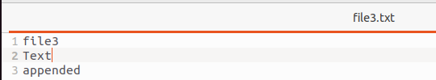
APPEND
09

Slide 21
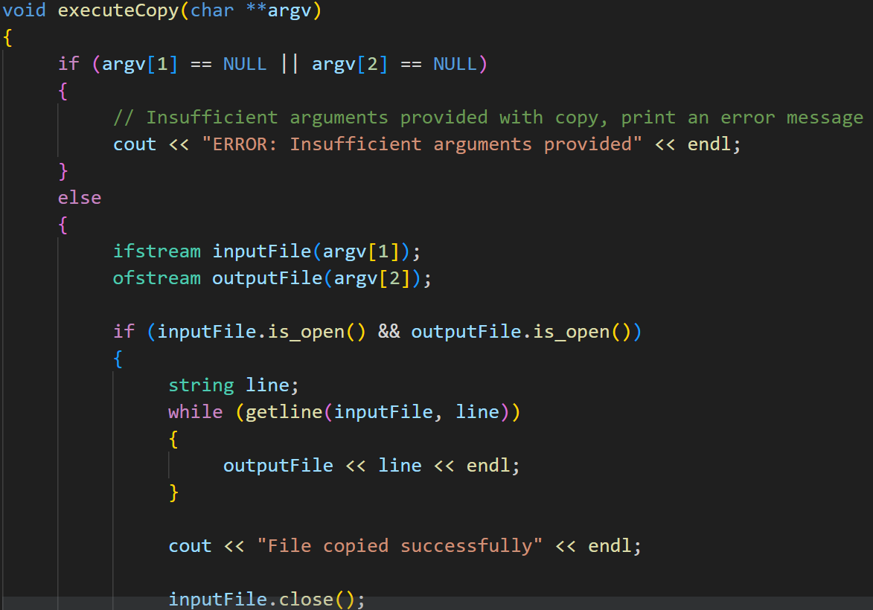
10
COPY
This command allows us to copy the contents of one file into another file.

Slide 22
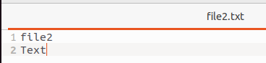
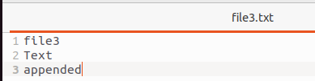
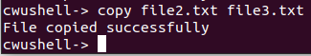
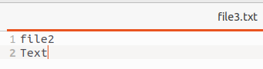
COPY
10
BEFORE
AFTER

Slide 23
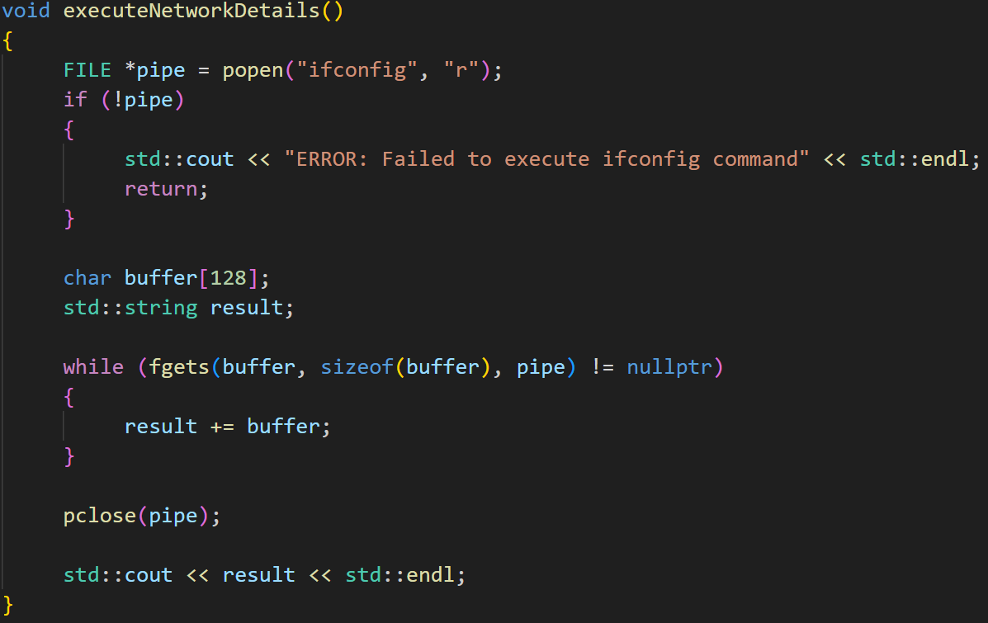
11
NETWORK
This command allows us to display the configure and display network interfaces, including their IP addresses, status (up or down), and other relevant information.

Slide 24
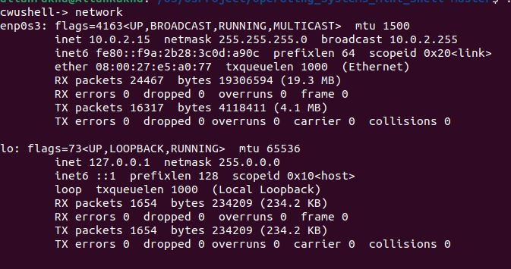
NETWORK
11

Slide 25
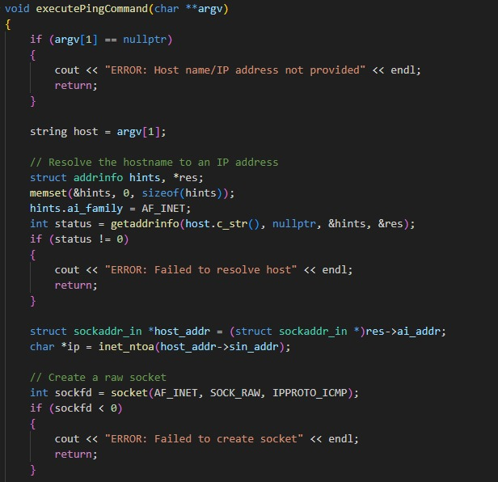
12
PING
This command allows us to troubleshoot network issues, check the availability of a remote host, and measure network latency.

Slide 26
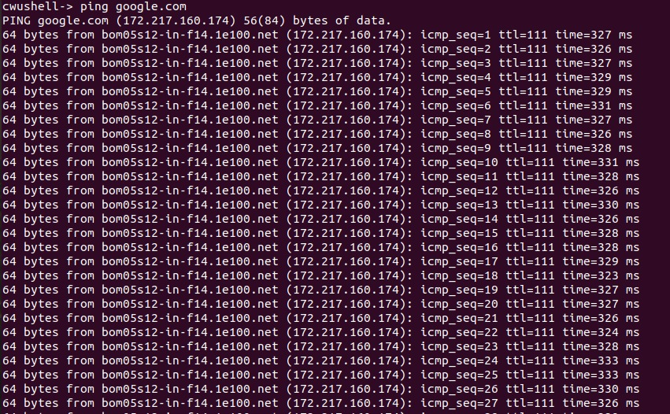
PING
12

Slide 27
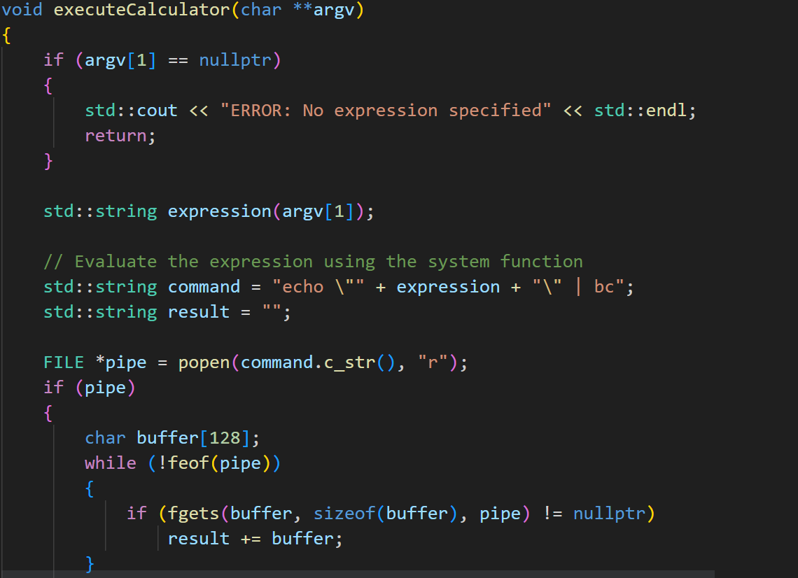
13
CALCULATOR
This command allows us to perform simple arithmetic operations

Slide 28
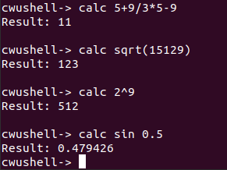
CALCULATOR
13

Slide 29
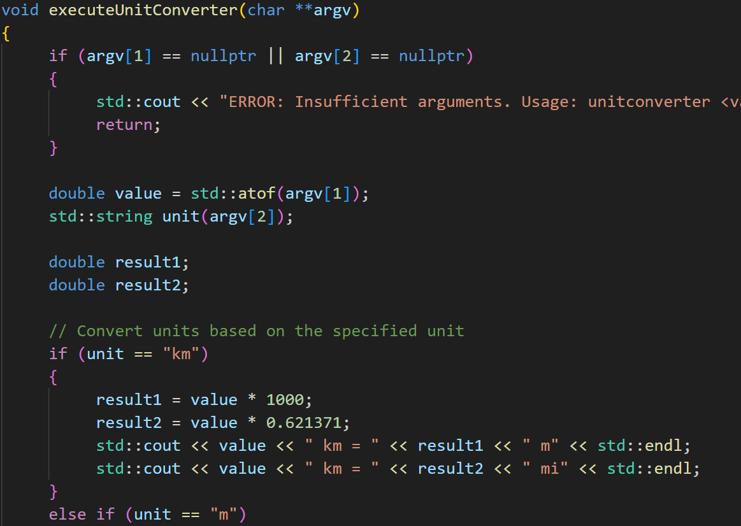
14
UNIT CONVERTER
This command allows us to convert from one unit to another.

Slide 30
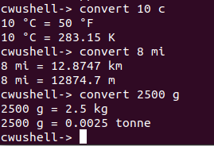
UNIT CONVERTER
14

Slide 31
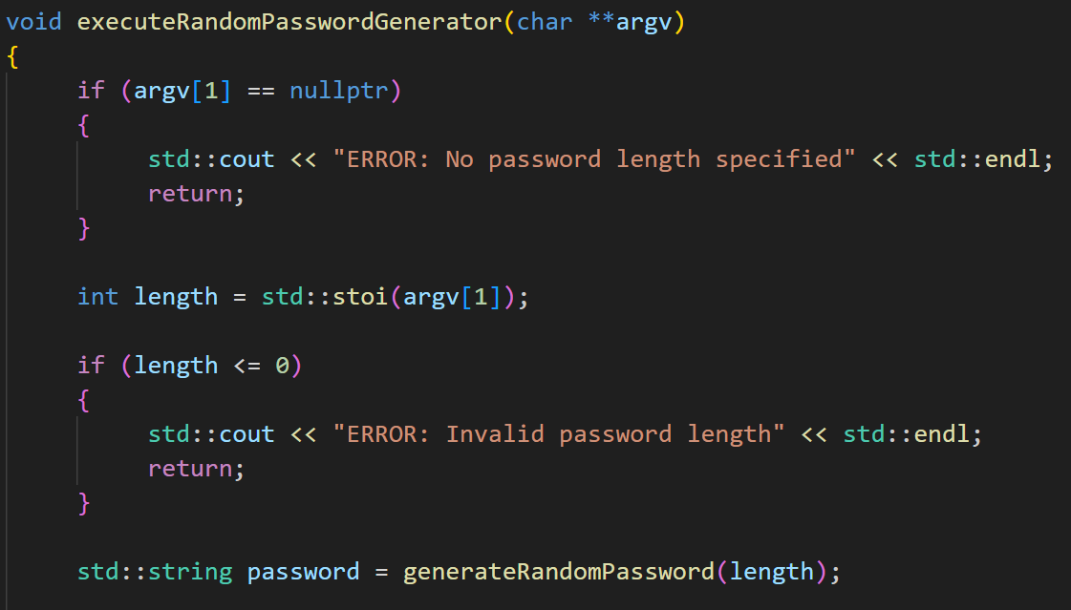
15
PASSWORD GENERATOR
This command allows us to generate a random password of a specified length.

Slide 32
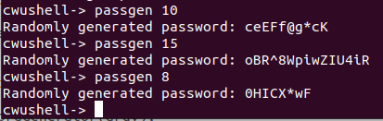
PASSWORD GENERATOR
15

Slide 33
Group Contribution
Allah Rakha – 5 Commands (Kill, Line Count, Swap, Top , Open)
Samama Farooq – 5 Commands (Network, Ping, Calculator, Unit Conv. , Pass. Generator)
Sohaib Ahsan – 5 Commands (Cd, Append, History, Copy, CMP)

Slide 34
"The only limit to our realization of tomorrow will be our doubts of today"
Thank You For Paying
Attention!
-Franklin D. Roosevelt

